Slide 1


Slide 2
AIM OF THE PROJECT
This project is all about finding the answers of the questions that we are looking for.
In this project, our main focus is to analyze major trends about the hiring process like number of rejections, number of interviews, types of jobs, vacancies etc. which are important to analyze before recruitment drive.

Slide 3
TECHNOLOGY STACK USED
Microsoft Excel – To import the datasets, cleaning of data, filtering of data, analyze the data using various formula and tools and then visualize it using various graphs and charts.
Microsoft Power Point – To create PPT that includes Useful Insights
and Solutions for our Business Problems.

Slide 4
Number of Males v/s Number of Females
Number of Males Hired | Number of Females Hired
2563 | 1856

Slide 5
AVERAGE SALARY
Excel Formulae used in this analysis is:-
=AVERAGEIFS(B:B,A:A,”Hired”)
Average Salary Offered
49752.9

Slide 6
CLASS INTERVAL FOR SALARY
Using Pivot table Selecting application_id, Salary offered and grouping them.
Salary Range | Employees
(blank) | 1
100-10099 | 443
10100-20099 | 480
20100-30099 | 481
30100-40099 | 465
40100-50099 | 513
50100-60099 | 500
60100-70099 | 453
70100-80099 | 476
80100-90099 | 459
90100-100099 | 423
190100-200099 | 1
290100-300099 | 1
390100-400099 | 1

Slide 7
EMPLOYEES IN DIFFERENT DEPARTMENT
EXCEL FORMULA USED:-
=COUNTIFS(E:E,”Finance Department”,C:C,”Hired”)
Department Name | Count
Finance Department | 177
General Management | 114
HR Department | 71
Marketing Department | 203
Operations Department | 1844
Production Department | 247
Purchase Department | 231
Sales Department | 486
Service Department | 1333

Slide 8
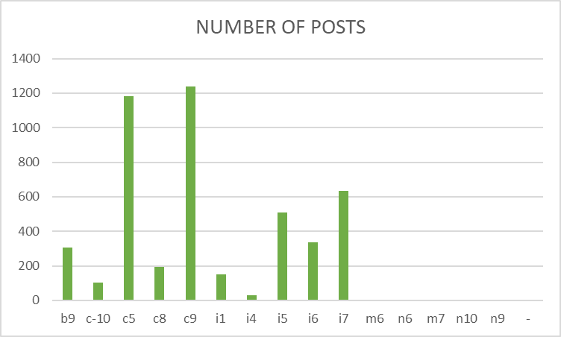
DIFFERENT POST TIERS
EXCEL FORMULAE USED:-
=COUNTIFS(C:C,”b9”,A:A,”Hired”)
POST NAME | NUMBER OF POSTS
b9 | 308
c-10 | 105
c5 | 1182
c8 | 193
c9 | 1239
i1 | 151
i4 | 32
i5 | 511
i6 | 337
i7 | 635
m6 | 2
n6 | 1
m7 | 0
n10 | 0
n9 | 0
- | 1

Slide 9
CONCLUSION
I have learnt a lot while working on this project like how to clean and filter the data, Analyze the data, Using different tools and formulas in excel, using statistics and how to visualize the data to get the clear picture of our desired solution.
This project gives me opportunity to implement my Excel and statistics learning into a real world problem in order to derive useful insights.

Slide 10


